Slide 1
Machine learning clustering algorithms-II

Slide 2


Slide 3
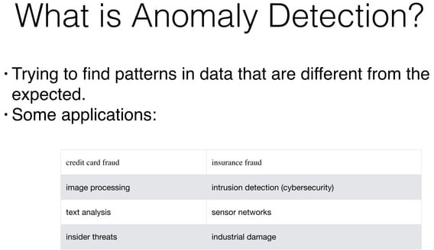

Slide 4
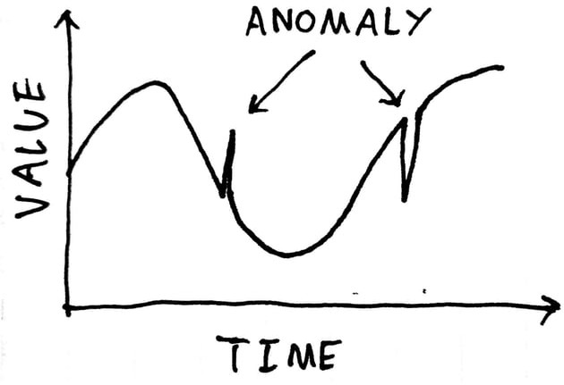

Slide 5
Anomaly detection in machine learning is the process of identifying data points or patterns that deviate significantly from the normal behavior or expected patterns within a dataset.
These deviant data points are often referred to as anomalies, outliers, novelties, or exceptions.
Anomaly detection has applications across various domains, including fraud detection, network security, industrial quality control, health monitoring, and more.
The primary goal of anomaly detection is to flag or identify instances that are rare, unusual, or potentially indicative of a problem, error, or malicious activity. Unlike traditional classification tasks where the goal is to classify data into predefined categories, anomaly detection focuses on identifying instances that do not conform to any known pattern.

Slide 6
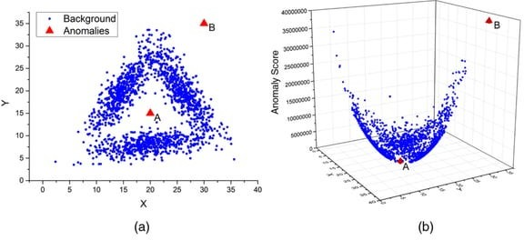

Slide 7
In the context of machine learning, background anomalies refer to data points or patterns that do not represent actual anomalies or outliers but are incorrectly labeled as such due to factors unrelated to the underlying data distribution or true anomalies.
Anomaly detection algorithms are designed to identify rare and unusual data points that deviate significantly from the majority of the data.
These anomalies could represent critical events, errors, fraud, or other important occurrences.

Slide 8
Background anomalies can arise from various sources:
Labeling Errors: Sometimes, anomalies are labeled inaccurately during the training phase, leading the model to learn incorrect patterns as anomalies. This can happen due to human error or misinterpretation of data.
Noise in Data: Data can have inherent noise due to measurement errors, sensor inaccuracies, or other factors. The noise can lead to the identification of false anomalies.
Seasonal or Temporal Variation: Data distributions can change over time or with different conditions. Anomalies detected during one time period might be considered background data points in another period due to changing data characteristics.
Data Transformation: If data undergoes various transformations or preprocessing steps, some of these steps might introduce patterns that appear anomalous but are not truly meaningful anomalies.

Slide 9
5. Imbalanced Data: Anomaly detection often deals with imbalanced datasets, where the majority of data points are normal and only a small portion are anomalies. This imbalance can lead to incorrect model behavior, causing the model to misclassify normal data points as anomalies.
Contextual Changes: What might be considered an anomaly in one context might be a regular occurrence in a different context. If context is not properly accounted for, background anomalies can occur.
7. Model Biases: The chosen algorithm and its hyperparameters can introduce biases that affect the detection of anomalies. Some algorithms might be overly sensitive to certain patterns or noise, leading to background anomalies.

Slide 10
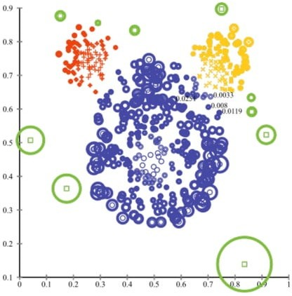

Slide 11
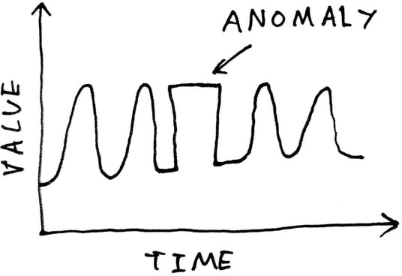

Slide 12
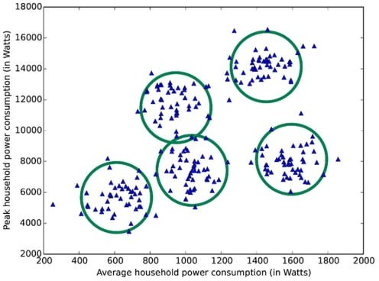

Slide 13
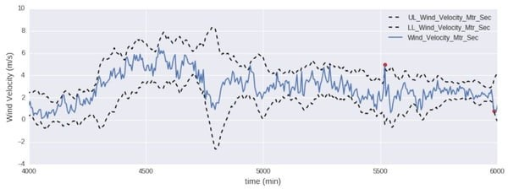

Slide 14
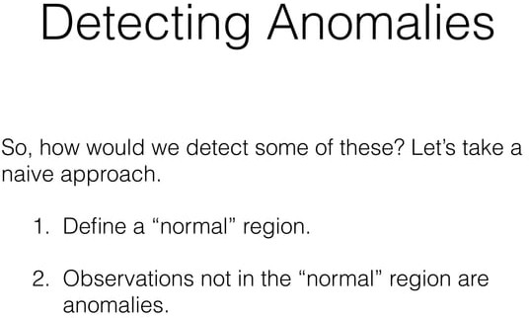

Slide 15
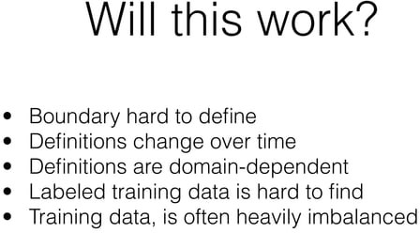

Slide 16
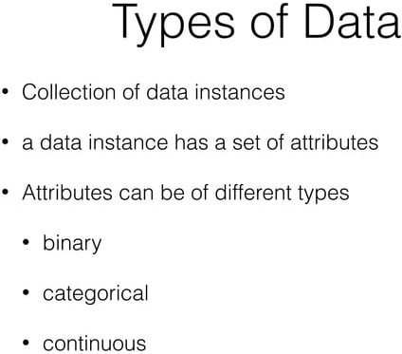

Slide 17
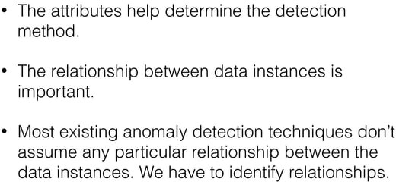

Slide 18
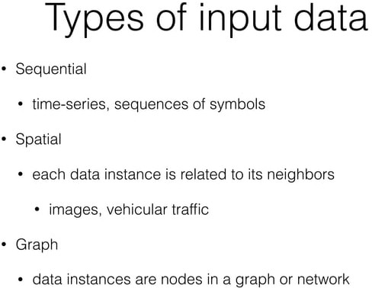

Slide 19
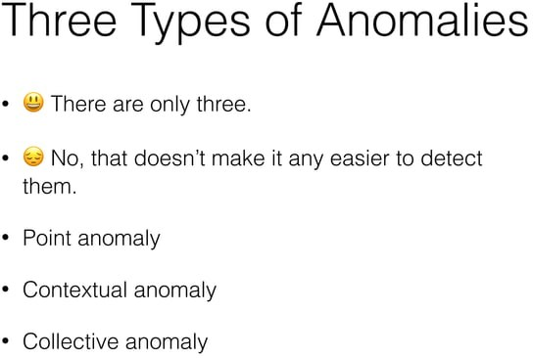

Slide 20
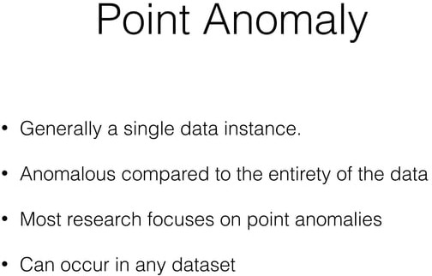

Slide 21
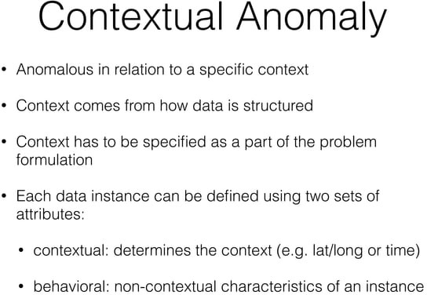

Slide 22
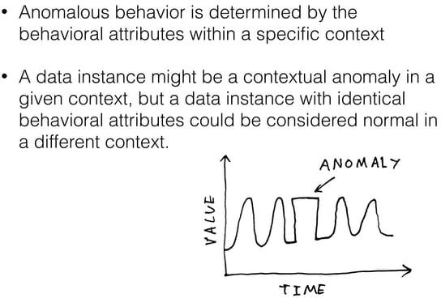

Slide 23
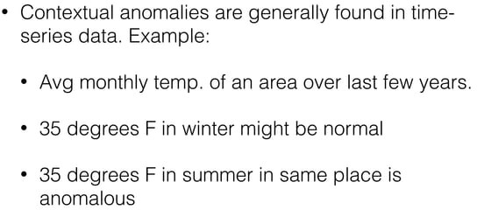

Slide 24
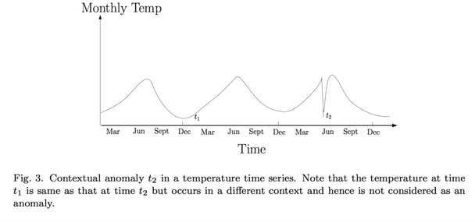

Slide 25
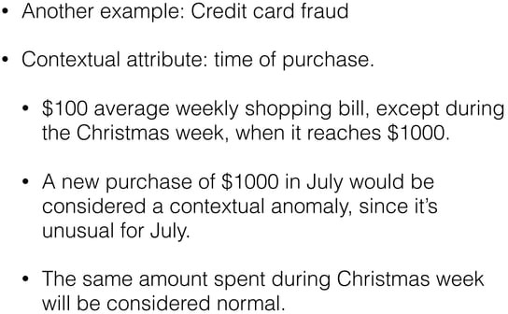

Slide 26
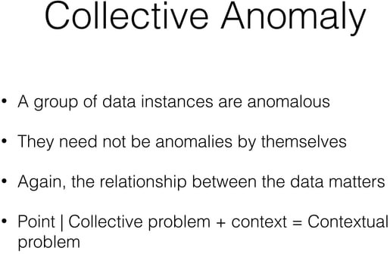

Slide 27
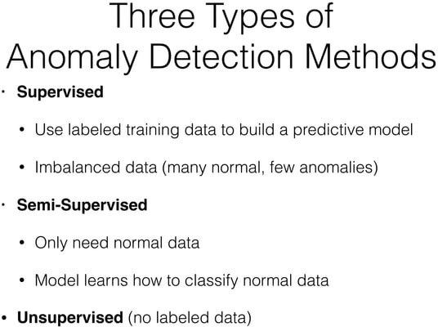

Slide 28


Slide 29
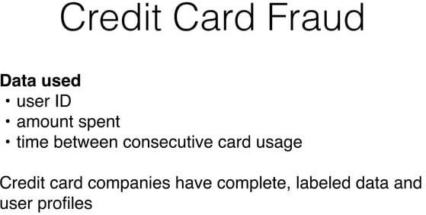

Slide 30
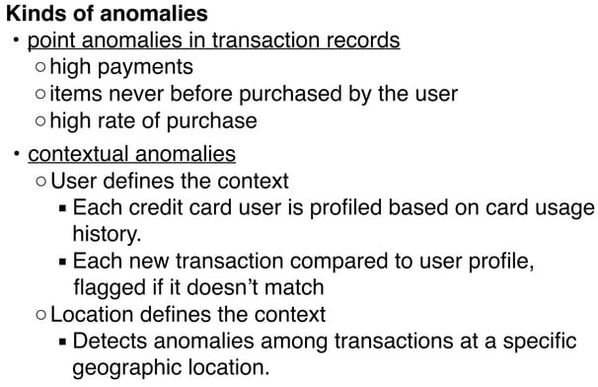

Slide 31
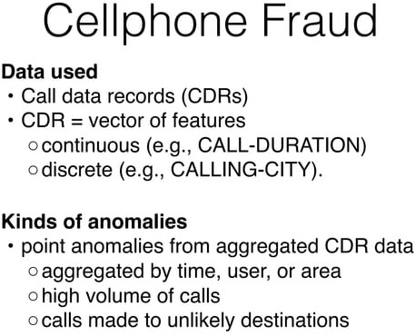

Slide 32
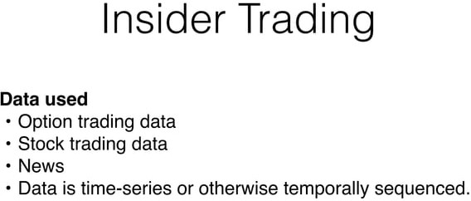

Slide 33


Slide 34
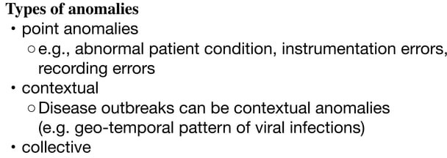

Slide 35
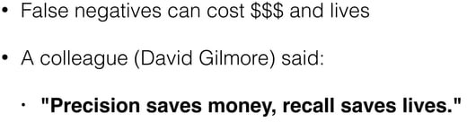

Slide 36
True Positive (TP): The model correctly classifies a positive instance as positive.
False Positive (FP): The model incorrectly classifies a negative instance as positive.
True Negative (TN): The model correctly classifies a negative instance as negative.
False Negative (FN): The model incorrectly classifies a positive instance as negative.
Precision = TP / (TP + FP)
Recall = TP / (TP + FN)

Slide 37
Precision answers the question: "Of all instances predicted as positive, how many are actually positive?”
A high precision indicates that when the model predicts a positive instance, it is usually correct.
However, high precision does not necessarily mean that the model is capturing all positive instances, as it could be ignoring some true positive cases.
Recall answers the question: "Of all actual positive instances, how many did the model correctly predict?”
A high recall indicates that the model is effectively identifying most of the positive instances.
However, a high recall might come at the cost of increased false positives, meaning that the model might also predict some negative instances as positive.

Slide 38


Slide 39
Anomaly detection methods can be broadly categorized into the following types:
Statistical Methods: These methods assume that normal data points follow a certain statistical distribution (e.g., Gaussian distribution). Anomalies are then identified as instances that deviate significantly from this distribution. Common statistical techniques include z-score, modified z-score, and percentile-based approaches.
Machine Learning Algorithms: These algorithms learn patterns from labeled training data and use this knowledge to identify anomalies in new, unlabeled data. Popular machine learning approaches include:
Isolation Forest: Constructs a random forest of decision trees and identifies instances that require fewer splits to isolate.
One-Class SVM: Learns a hyperplane that separates normal instances from anomalies in a high-dimensional space.

Slide 40
Autoencoders: Neural network architectures that aim to reconstruct the input data and identify instances with high reconstruction errors as anomalies.
Density-Based Approaches: Clustering methods like DBSCAN can identify regions of high-density (normal data) and low-density (anomalies) in the data space.
Proximity-Based Methods: These methods compute distances or similarities between data points and flag instances that are distant from the majority of points. The k-nearest neighbors algorithm is a common example.

Slide 41
Time Series Anomaly Detection: This subset of anomaly detection focuses on identifying unusual patterns in time series data. Techniques like moving average, exponential smoothing, and dynamic time warping are often used.
Domain-Specific Approaches: Some domains require specialized techniques. For example, in network security, intrusion detection systems utilize anomaly detection to identify unusual patterns in network traffic.

Slide 42
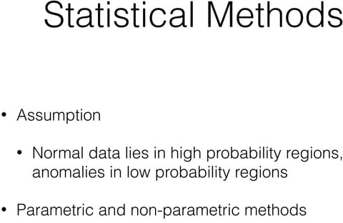

Slide 43
Parametric and non-parametric are terms used in statistics to describe different approaches to modeling data distributions. The distinction applies not just to normal distributions, but to distributions in general.
Parametric Distribution: A parametric distribution assumes that the data follows a specific known distribution with a fixed set of parameters. For example, the normal distribution is a parametric distribution with parameters mean (μ) and standard deviation (σ). In a parametric approach, you make assumptions about the form of the distribution and estimate its parameters from the data.
Advantages of Parametric Distributions:
When the data truly follows the assumed distribution, parameter estimation can be very efficient.
Parameters have interpretable meanings.
Disadvantages of Parametric Distributions:
If the data doesn't fit the assumed distribution, the model might provide poor estimates.
Can be restrictive if the true distribution doesn't match the assumed distribution.

Slide 44
Non-Parametric Distribution: A non-parametric distribution makes minimal assumptions about the underlying distribution of the data. Instead of specifying a fixed distribution, non-parametric methods focus on estimating various characteristics of the distribution without making strong assumptions about its shape.
Advantages of Non-Parametric Distributions:
More flexible and can fit a wider range of data distributions.
Suitable for cases where the true distribution is unknown or complex.
Disadvantages of Non-Parametric Distributions:
Often require more data for accurate estimation.
Results might be less interpretable due to the lack of a specific distribution assumption.

Slide 45
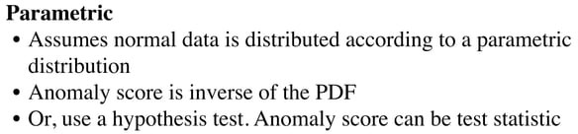

Slide 46
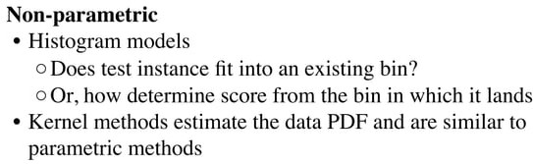

Slide 47
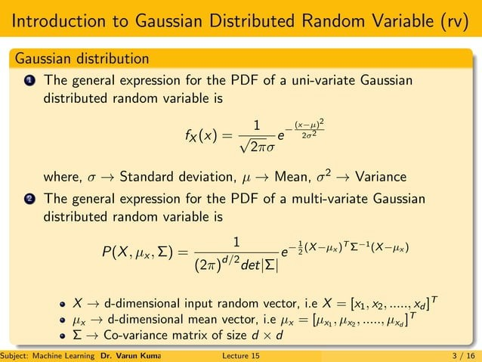

Slide 48
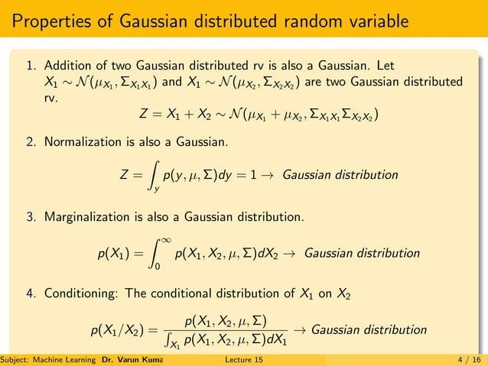

Slide 49
Gaussian Distribution
In this approach, all the features are modeled on a Gaussian Distribution and given a new data-point, the probability of the data-point is given by Gaussian/Normal Distribution Function.
If the probability is below a particular threshold (which is set depending upon the performance of the model on the Validation Set), the new data-point is claimed to be an outlier or anomalous.

Slide 50
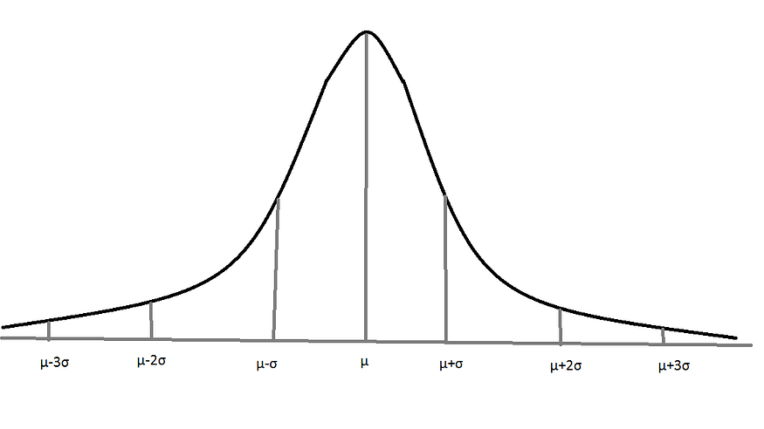
Gaussian/Normal Distribution with Mean = µ and Standard Deviation = σ

Slide 51
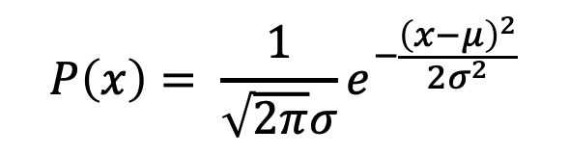
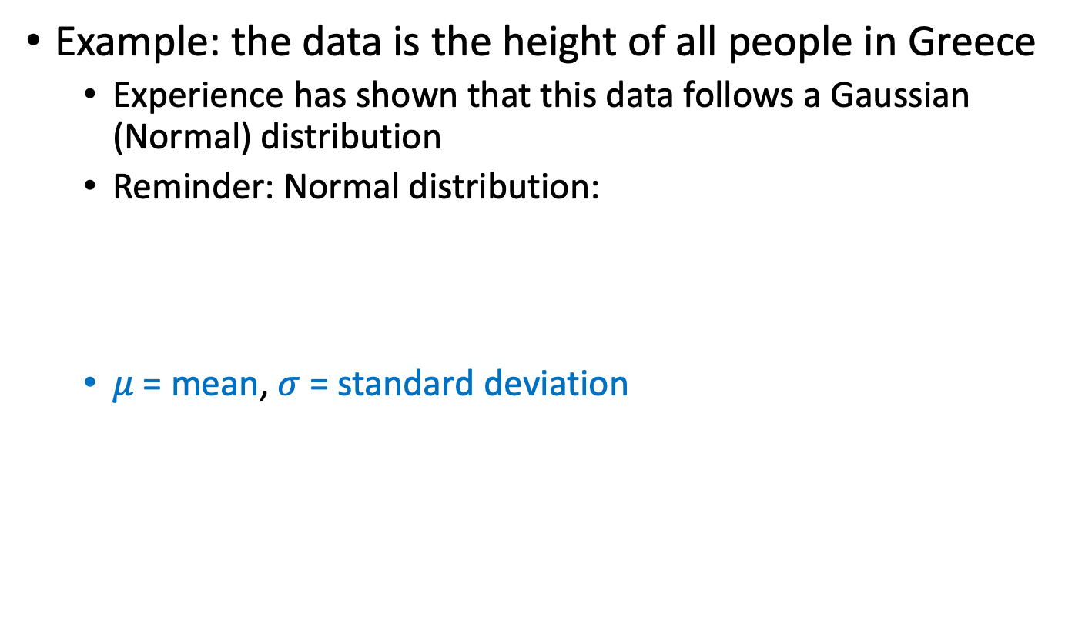
Gaussian Distribution
Example: the data is the height of all people in Greece
Experience has shown that this data follows a Gaussian (Normal) distribution
Reminder: Normal distribution:
$μ$= mean, $σ$= standard deviation
$$P\left(x\right)= \frac{1}{\sqrt{2π}σ}e^{−\frac{{\left(x−μ\right)}^{2}}{2σ^{2}}}$$

Slide 52
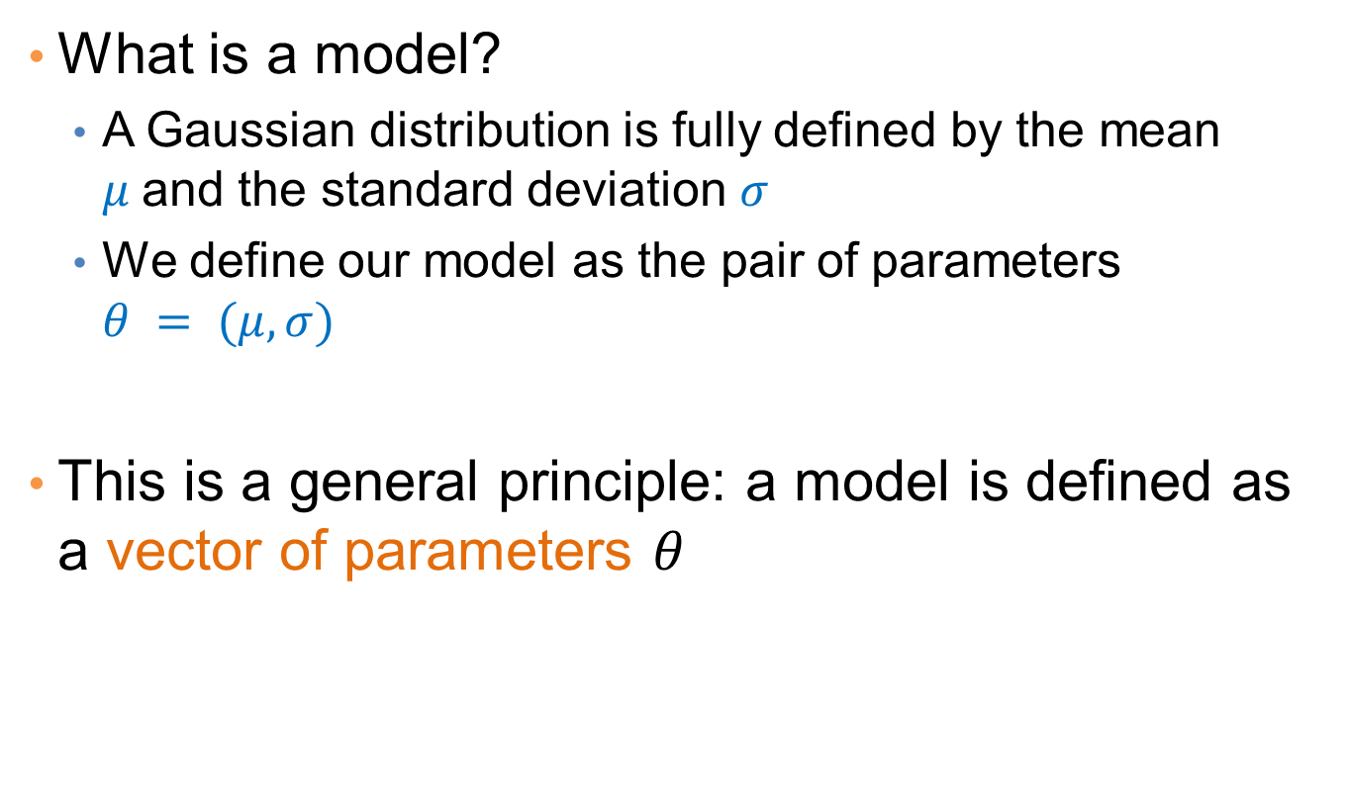
Gaussian Model
What is a model?
A Gaussian distribution is fully defined by the mean $μ$and the standard deviation $σ$
We define our model as the pair of parameters $θ = (μ, σ)$
This is a general principle: a model is defined as a vector of parameters $θ$

Slide 53
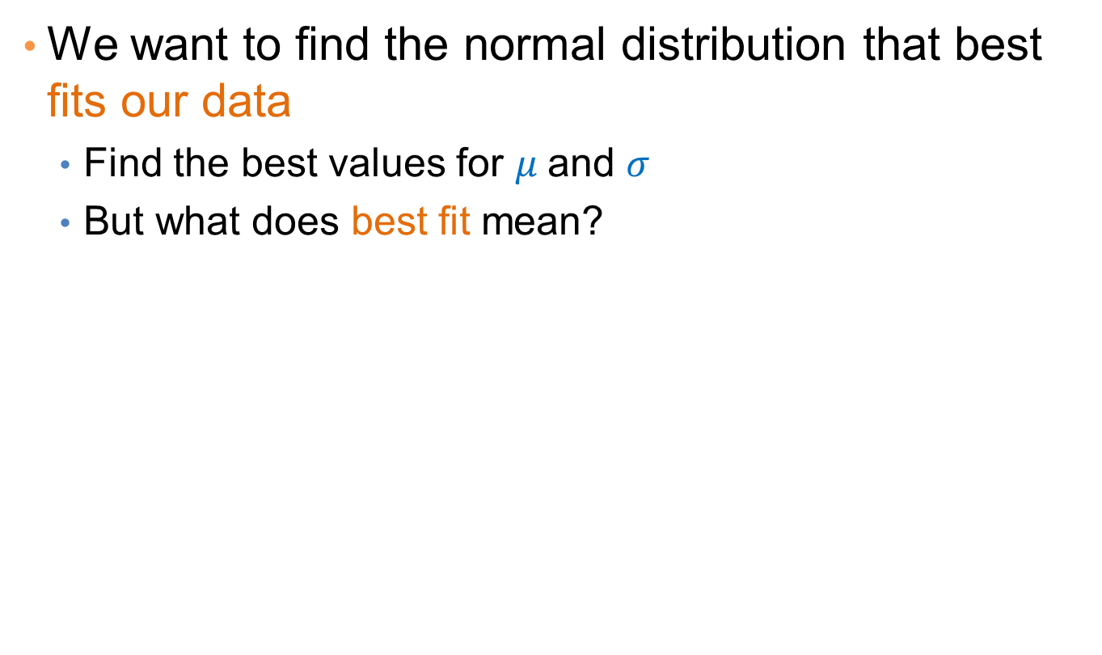
Fitting the model
We want to find the normal distribution that best fits our data
Find the best values for $μ$and $σ$
But what does best fit mean?

Slide 54
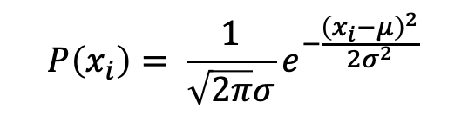
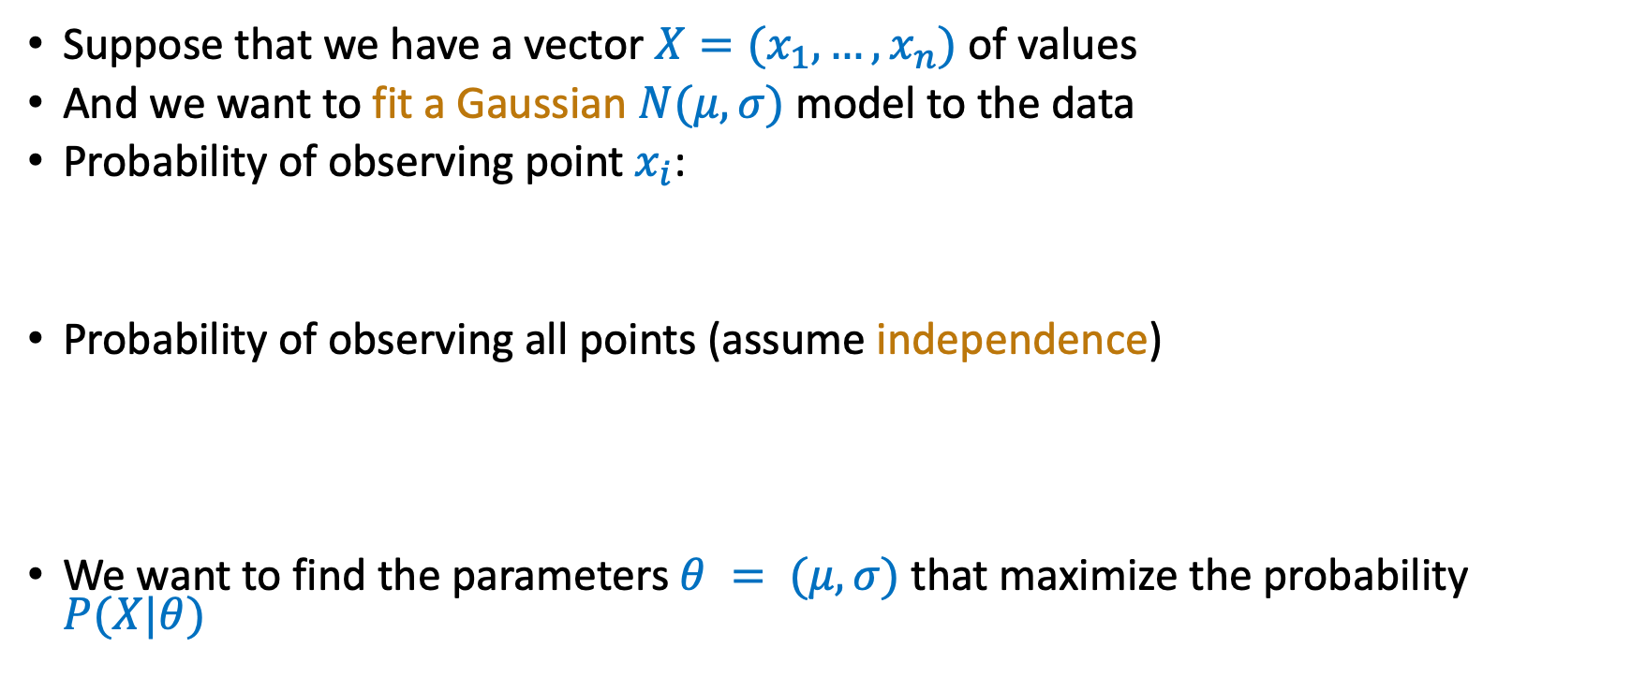
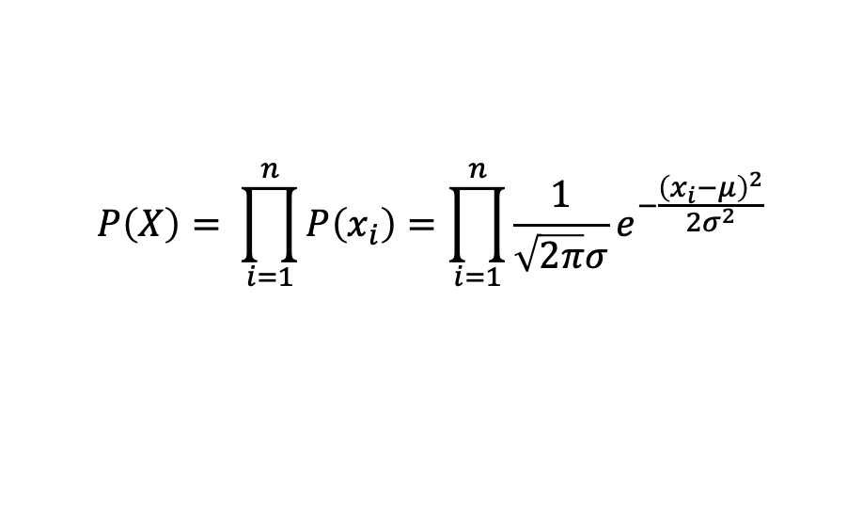
Maximum Likelihood Estimation (MLE)
Suppose that we have a vector $X=(x_{1},…,x_{n})$of values
And we want to fit a Gaussian $N(μ,σ)$model to the data
Probability of observing point $x_{i}$:
Probability of observing all points (assume independence)
We want to find the parameters $θ = (μ, σ)$that maximize the probability $P(X|θ)$
$$P\left(x_{i}\right)= \frac{1}{\sqrt{2π}σ}e^{−\frac{{\left(x_{i}−μ\right)}^{2}}{2σ^{2}}}$$
$$P\left(X\right)= \prod_{i=1}^{n}{P\left(x_{i}\right)}=\prod_{i=1}^{n}{\frac{1}{\sqrt{2π}σ}e^{−\frac{{\left(x_{i}−μ\right)}^{2}}{2σ^{2}}}}$$

Slide 55
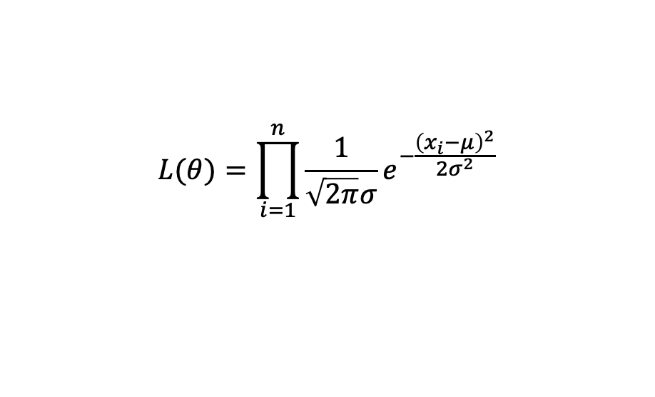
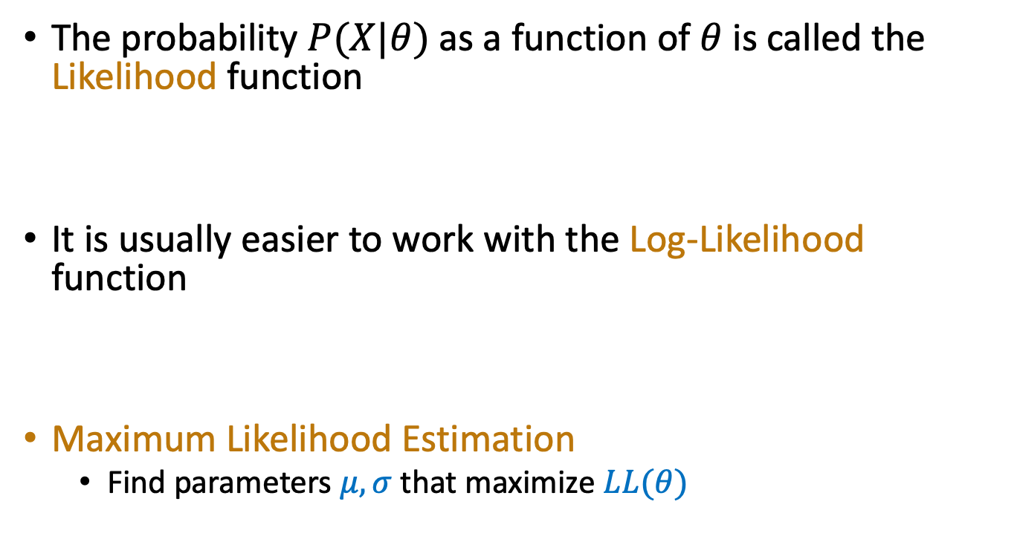
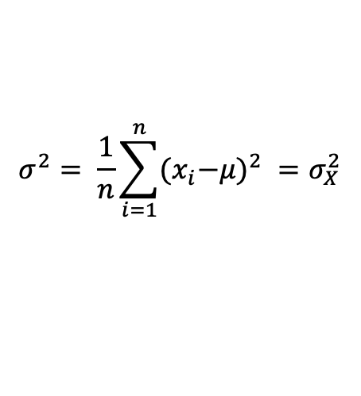
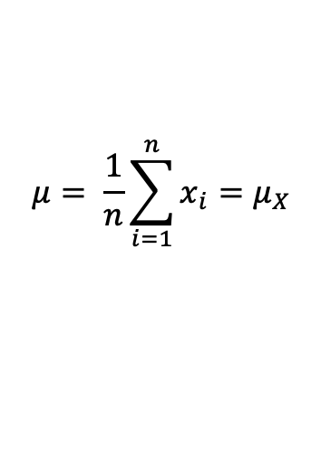
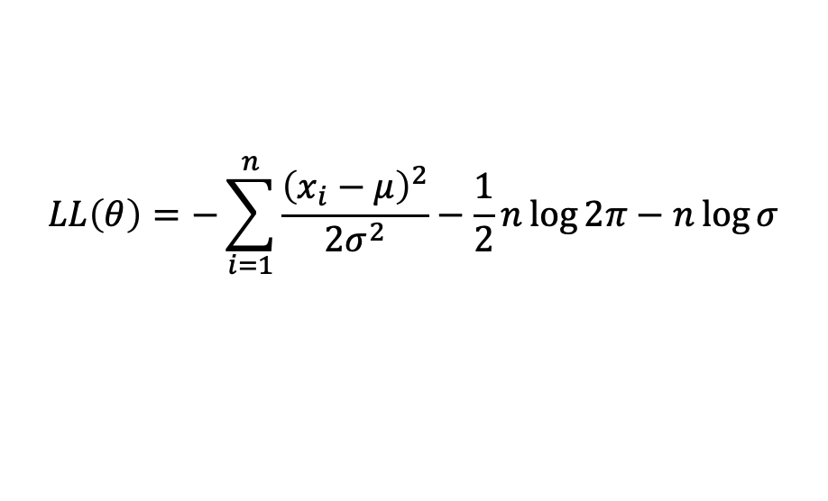
Maximum Likelihood Estimation (MLE)
The probability $P(X|θ)$as a function of $θ$is called the Likelihood function
It is usually easier to work with the Log-Likelihood function
Maximum Likelihood Estimation
Find parameters $μ, σ$that maximize $LL(θ)$
$$L(θ)=\prod_{i=1}^{n}{\frac{1}{\sqrt{2π}σ}e^{−\frac{{\left(x_{i}−μ\right)}^{2}}{2σ^{2}}}}$$
$$LL\left(θ\right)=−\sum_{i=1}^{n}{\frac{{\left(x_{i}−μ\right)}^{2}}{2σ^{2}}−\frac{1}{2}n\log{2π}−n\log{σ}}$$
$$μ= \frac{1}{n}\sum_{i=1}^{n}{x_{i}=μ_{X}}$$
$$σ^{2}= \frac{1}{n}\sum_{i=1}^{n}{{{(x}_{i}−μ)}^{2} }=σ_{X}^{2}$$
Sample Mean
Sample Variance

Slide 56
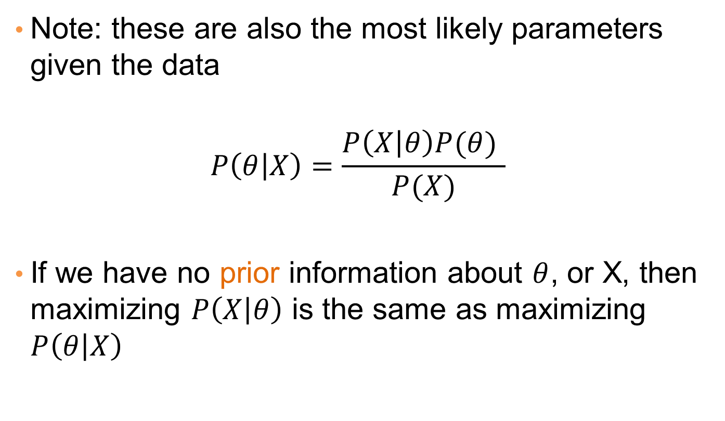
MLE
Note: these are also the most likely parameters given the data
$$P\left(θ | X\right)=\frac{P\left(X | θ\right)P(θ) }{P(X)}$$
If we have no prior information about $θ$, or X, then maximizing $P\left(X | θ\right)$ is the same as maximizing $P\left(θ | X\right)$

Slide 57
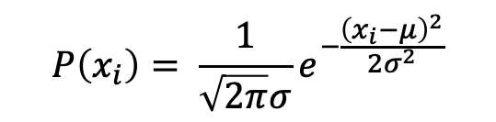
Gaussian Distribution Anomaly Detection Algorithm:
Let us consider that there are m data-points (instances) each with n selected features.
The Mean parameter for each feature (j = 1 to n) is fit.
The Variance parameter for each feature (j = 1 to n) is fit.
Given a new data-point, x = {x_1, x_2, … , x_j}, p(x) is given by:
Now, a threshold parameter, ε is selected such that,
if p(x) < ε: # x is an ANOMALY or OUTLIER !!!! else: # x is NOT an ANOMALY or OUTLIER !!!!
$$P\left(x_{i}\right)= \frac{1}{\sqrt{2π}σ}e^{−\frac{{\left(x_{i}−μ\right)}^{2}}{2σ^{2}}}$$

Slide 58
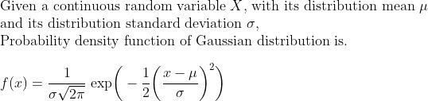
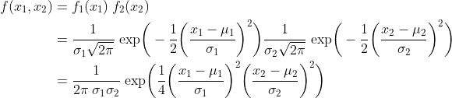
The probability density function, defined as f(x), measures the probability of some outcome x
For a two uncorrelated feature case, this becomes

Slide 59
Machine Learning Algorithm

Slide 60
Isolation Trees and traditional Decision Trees are both tree-based algorithms, but they serve different purposes, particularly in the context of anomaly detection.
Purpose:
Isolation Trees (Isolation Forest): Isolation Trees are designed specifically for anomaly detection. They focus on quickly isolating anomalies from normal instances by creating a collection of shallow and random decision trees. The idea is that anomalies are easier to separate from the majority of instances with fewer splits.
Traditional Decision Trees: Traditional decision trees are used for classification or regression tasks, where the goal is to predict a target variable based on input features. They aim to partition the data based on features to make predictions about target variables.

Slide 61
Isolation Trees and traditional Decision Trees are both tree-based algorithms, but they serve different purposes, particularly in the context of anomaly detection.
Anomaly Identification:
Isolation Trees (Isolation Forest): The anomalies are expected to have shorter paths in Isolation Trees due to their rarity and different nature. During anomaly identification, the average path length from the root node to a given data point is used to determine whether it's an anomaly.
Traditional Decision Trees: Traditional decision trees do not have an inherent mechanism for anomaly detection. They are not explicitly designed for this purpose, and their use for anomaly detection would be more indirect and less effective.

Slide 62
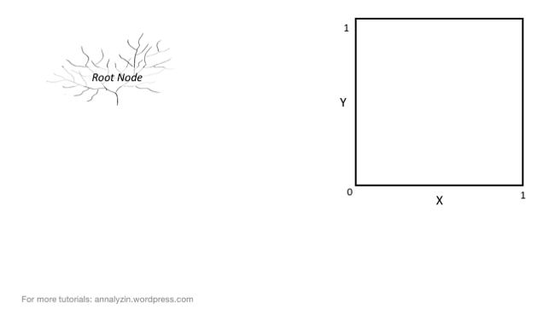

Slide 63


Slide 64
In summary, while both Isolation Trees and traditional Decision Trees are tree-based algorithms, Isolation Trees are specifically designed for efficient anomaly detection by isolating anomalies from normal instances.
Traditional Decision Trees are more suited for predictive modeling tasks where the goal is to predict target variables based on input features.
To perform anomaly detection, Isolation Forest is generally a more suitable approach.

Slide 65
Isolation Forest
Isolation Forest is a machine learning algorithm specifically designed for anomaly detection.
It works by isolating anomalies in a dataset using random forests.
This algorithm is efficient and effective, particularly for high-dimensional data or data with complex patterns.

Slide 66
Algorithm
Isolation Concept:
The fundamental idea behind Isolation Forest is that anomalies are easier to isolate than normal data points. In other words, anomalies require fewer partitions to be separated from the rest of the data.
Random Partitioning:
Isolation Forest randomly selects a feature and a random split value within the range of that feature for each decision tree it builds.
Tree Construction:
The algorithm constructs a forest of isolation trees. Each tree is grown recursively by partitioning the data into subsets using the random splits mentioned earlier.
Scoring Anomalies:
Anomalies have shorter average path lengths within the trees compared to normal data points. The path length is the number of edges traversed to isolate a data point. Anomalies are isolated faster, leading to shorter path lengths.

Slide 67
Anomaly Score:
The anomaly score for a data point is the average path length across all the trees in the forest. This score reflects how easily the point can be separated from the rest.
Detection Threshold:
Anomalies tend to have lower anomaly scores compared to normal data points. By setting a threshold on the anomaly score, you can classify data points as anomalies if their scores are below the threshold.

Slide 68


Slide 69


Slide 70


Slide 71


Slide 72


Slide 73


Slide 74


Slide 75


Slide 76
Anomaly/Outlier Detection
What are anomalies/outliers?
The set of data points that are considerably different than the remainder of the data
Variants of Anomaly/Outlier Detection Problems
Given a database D, find all the data points x ∈ D with anomaly scores greater than some threshold t
Given a database D, find all the data points x ∈ D having the top-n largest anomaly scores f(x)
Given a database D, containing mostly normal (but unlabeled) data points, and a test point x, compute the anomaly score of x with respect to D

Slide 77
Clustering-Based algorithm anomaly detection
Outlier score defined as relative distance. It is the ratio of the distance of point from the closest centroid to the median distance of all points in the cluster from the centroid.

Slide 78
Clustering-Based algorithm of anomaly detection
Algorithm 2 Basic clustering-based algorithm of anomaly detection
Find position of K centroids (Algorithm 1)
Find median distance for each centroid
Calculate the score of each pont that is :(dist of point to nearest centroid)/(median dist. for given nearist centorid)
Order the scores to define outliers.

Slide 79
Clustering-Based. Strength and Weaknesses
Some clustering techniques, such as K-mean, have linear or close to linear time and space complexity.
Possible to find both clusters and outliers at the same time.
The set of outliers produced and their score can be heavily dependent upon the number of clusters as well as the presence of outliers in the data.
The quality of outliers produced by a clustering is heavily impacted by the quality of clusters produced by algorithm.
The clustering algorithm needs to be chosen carefully.

Slide 80

Anomaly Detection vs. Supervised Learning

Slide 81
Role of PCA in anomaly detection
Principal Component Analysis (PCA) plays a significant role in anomaly detection by reducing the dimensionality of data while retaining the most important information.
This dimensionality reduction can enhance the performance of anomaly detection algorithms and make them more effective.
It's often used as a preprocessing step to prepare the data for subsequent anomaly detection methods.

Slide 82
Deciding which features to use when incorporating Principal Component Analysis (PCA) for anomaly detection involves a combination of domain knowledge, data exploration, and experimentation.
Following are the steps to determine which features to include in your PCA-based anomaly detection:
Understand the Problem Domain: Begin by gaining a clear understanding of the problem you're addressing and the context of your data. Know the key factors that could influence anomalies and what features are likely to be relevant.
Feature Selection: Before applying PCA, consider whether you can reduce the dimensionality by selecting a subset of features that are most relevant to the problem. Feature selection can help retain interpretability and focus PCA on the most important aspects.

Slide 83
Data Exploration: Explore your data to identify potential patterns and relationships. Visualize the data using scatter plots, histograms, and other visualization techniques. This can help you understand how features interact and whether there are distinct clusters or patterns.
Correlation Analysis: Examine the correlations between features. Highly correlated features might carry redundant information, and including all of them in PCA could lead to overemphasis on certain aspects.
Normalization/Standardization: Standardize or normalize your features before applying PCA. This ensures that all features contribute proportionally to the principal components, regardless of their original scales.

Slide 84
Variance Explained: Compute the explained variance ratio for each principal component. This helps you understand how much variance is captured by each component. Decide how many principal components to retain based on a cumulative variance threshold (e.g., 95% or 99%) that retains a significant portion of the data's variability.
Cross-Validation: Use cross-validation techniques to assess the performance of your anomaly detection algorithm with different subsets of principal components. This can help you choose an optimal number of components that balances performance and complexity.
Iterate and Experiment: Experiment with different combinations of features and principal components. Compare the results of different configurations in terms of anomaly detection accuracy, false positives, false negatives, and interpretability.
Evaluate on Validation/Test Data: Always evaluate your PCA-based anomaly detection approach on separate validation or test data to ensure that the chosen features and principal components generalize well to unseen instances.

Slide 85
Hierarchical Clustering
Two main types of hierarchical clustering
Agglomerative:
Start with the points as individual clusters
At each step, merge the closest pair of clusters until only one cluster (or k clusters) left
Divisive:
Start with one, all-inclusive cluster
At each step, split a cluster until each cluster contains a point (or there are k clusters)
Traditional hierarchical algorithms use a similarity or distance matrix
Merge or split one cluster at a time

Slide 86
Hierarchical Clustering
Produces a set of nested clusters organized as a hierarchical tree
Can be visualized as a dendrogram
A tree like diagram that records the sequences of merges or splits

Slide 87
Strengths of Hierarchical Clustering
Do not have to assume any particular number of clusters
Any desired number of clusters can be obtained by ‘cutting’ the dendogram at the proper level
They may correspond to meaningful taxonomies
Example in biological sciences (e.g., animal kingdom, phylogeny reconstruction, …)

Slide 88
The main difference lies in the terminology…!!!
Hierarchical Clustering: This refers to the general idea of creating a hierarchy of clusters, regardless of the method used. It's a broader concept.
Agglomerative Clustering: This is a specific method within hierarchical clustering where clusters are formed by merging the closest data points or clusters in a bottom-up manner.

Slide 89
Agglomerative Clustering Algorithm
More popular hierarchical clustering technique
Basic algorithm is straightforward
Compute the proximity matrix
Let each data point be a cluster
Repeat
Merge the two closest clusters
Update the proximity matrix
Until only a single cluster remains
Key operation is the computation of the proximity of two clusters
Different approaches to defining the distance between clusters distinguish the different algorithms

Slide 90
Starting Situation
Start with clusters of individual points and a proximity matrix
p1
p2
p3
p4
p5
. . .
p1
p2
p3
p4
p5
.
.
.
Proximity Matrix

Slide 91
Intermediate Situation
After some merging steps, we have some clusters
C1
C2
C3
C4
C5
C1
C2
C3
C3
C4
C4
C5
C1
Proximity Matrix
C2
C5

Slide 92
Intermediate Situation
We want to merge the two closest clusters (C2 and C5) and update the proximity matrix.
C1
C2
C3
C4
C5
C1
C2
C3
C3
C4
C4
C5
Proximity Matrix
C1
C2
C5

Slide 93
After Merging
The question is “How do we update the proximity matrix?”
C2 U C5
C1
C3
C4
C1
?
C2 U C5
? ? ? ?
C3
C3
?
C4
C4
?
C1
Proximity Matrix
C2 U C5

Slide 94
How to Define Inter-Cluster Similarity
p1
p2
p3
p4
p5
. . .
p1
Similarity?
p2
p3
p4
p5
MIN
MAX
Group Average
Distance Between Centroids
Other methods driven by an objective function
Ward’s Method uses squared error
.
.
.
Proximity Matrix

Slide 95
How to Define Inter-Cluster Similarity
p1
p2
p3
p4
p5
. . .
p1
p2
p3
p4
p5
MIN
MAX
Group Average
Distance Between Centroids
Other methods driven by an objective function
Ward’s Method uses squared error
.
.
.
Proximity Matrix

Slide 96
How to Define Inter-Cluster Similarity
p1
p2
p3
p4
p5
. . .
p1
p2
p3
p4
p5
MIN
MAX
Group Average
Distance Between Centroids
Other methods driven by an objective function
Ward’s Method uses squared error
.
.
.
Proximity Matrix

Slide 97
How to Define Inter-Cluster Similarity
p1
p2
p3
p4
p5
. . .
p1
p2
p3
p4
p5
MIN
MAX
Group Average
Distance Between Centroids
Other methods driven by an objective function
Ward’s Method uses squared error
.
.
.
Proximity Matrix

Slide 98
How to Define Inter-Cluster Similarity
p1
p2
p3
p4
p5
. . .
p1
×
×
p2
p3
p4
p5
MIN
MAX
Group Average
Distance Between Centroids
Other methods driven by an objective function
Ward’s Method uses squared error
.
.
.
Proximity Matrix

Slide 99
Single Link – Complete Link
Another way to view the processing of the hierarchical algorithm is that we create links between their elements in order of increasing distance
The MIN – Single Link
The MAX – Complete Link

Slide 100
Hierarchical Clustering: MIN
 | 1 | 2 | 3 | 4 | 5 | 6
1 | 0 | .24 | .22 | .37 | .34 | .23
2 | .24 | 0 | .15 | .20 | .14 | .25
3 | .22 | .15 | 0 | .15 | .28 | .11
4 | .37 | .20 | .15 | 0 | .29 | .22
5 | .34 | .14 | .28 | .29 | 0 | .39
6 | .23 | .25 | .11 | .22 | .39 | 0
5
1
3
5
2
1
2
3
6
4
4
Nested Clusters
Dendrogram

Slide 101


Strength of MIN
Original Points
Two Clusters
Can handle non-elliptical shapes

Slide 102


Limitations of MIN
Original Points
Two Clusters
Sensitive to noise and outliers

Slide 103
Hierarchical Clustering: MAX
 | 1 | 2 | 3 | 4 | 5 | 6
1 | 0 | .24 | .22 | .37 | .34 | .23
2 | .24 | 0 | .15 | .20 | .14 | .25
3 | .22 | .15 | 0 | .15 | .28 | .11
4 | .37 | .20 | .15 | 0 | .29 | .22
5 | .34 | .14 | .28 | .29 | 0 | .39
6 | .23 | .25 | .11 | .22 | .39 | 0
4
1
2
5
5
2
3
6
3
1
4
Nested Clusters
Dendrogram

Slide 104

Strength of MAX
Original Points
Two Clusters
Less susceptible to noise and outliers

Slide 105


Limitations of MAX
Original Points
Two Clusters
Tends to break large clusters
Biased towards globular clusters

Slide 106
Cluster Similarity: Group Average
Proximity of two clusters is the average of pairwise proximity between points in the two clusters.
Need to use average connectivity for scalability since total proximity favors large clusters
 | 1 | 2 | 3 | 4 | 5 | 6
1 | 0 | .24 | .22 | .37 | .34 | .23
2 | .24 | 0 | .15 | .20 | .14 | .25
3 | .22 | .15 | 0 | .15 | .28 | .11
4 | .37 | .20 | .15 | 0 | .29 | .22
5 | .34 | .14 | .28 | .29 | 0 | .39
6 | .23 | .25 | .11 | .22 | .39 | 0

Slide 107
Hierarchical Clustering: Group Average
 | 1 | 2 | 3 | 4 | 5 | 6
1 | 0 | .24 | .22 | .37 | .34 | .23
2 | .24 | 0 | .15 | .20 | .14 | .25
3 | .22 | .15 | 0 | .15 | .28 | .11
4 | .37 | .20 | .15 | 0 | .29 | .22
5 | .34 | .14 | .28 | .29 | 0 | .39
6 | .23 | .25 | .11 | .22 | .39 | 0
5
4
1
2
5
2
3
6
1
4
3
Nested Clusters
Dendrogram

Slide 108


Slide 109


Slide 110


Slide 111


Slide 112


Slide 113


Slide 114


Slide 115


Slide 116


Slide 117


Slide 118


Slide 119


Slide 120


Slide 121
Hierarchical Clustering: Group Average
Compromise between Single and Complete Link
Strengths
Less susceptible to noise and outliers
Limitations
Biased towards globular clusters

Slide 122
Cluster Similarity: Ward’s Method
Similarity of two clusters is based on the increase in squared error (SSE) when two clusters are merged
Similar to group average if distance between points is distance squared
Less susceptible to noise and outliers
Biased towards globular clusters
Hierarchical analogue of K-means
Can be used to initialize K-means

Slide 123
Hierarchical Clustering: Comparison
5
1
4
1
3
2
5
5
5
2
1
MIN
2
MAX
2
3
6
3
3
6
1
4
4
4
5
5
1
4
1
2
2
5
2
Ward’s Method
5
2
3
6
Group Average
3
3
6
4
1
1
4
4
3

Slide 124
Hierarchical Clustering: Time and Space requirements
O(N²) space since it uses the proximity matrix.
N is the number of points.
O(N³) time in many cases
There are N steps and at each step the size, N², proximity matrix must be updated and searched
Complexity can be reduced to O(N² log(N) ) time for some approaches

Slide 125
Hierarchical Clustering: Problems and Limitations
Computational complexity in time and space
Once a decision is made to combine two clusters, it cannot be undone
No objective function is directly minimized
Different schemes have problems with one or more of the following:
Sensitivity to noise and outliers
Difficulty handling different sized clusters and convex shapes
Breaking large clusters

Slide 126
DBSCAN

Slide 127
DBSCAN: Density-Based Clustering
DBSCAN is a Density-Based Clustering algorithm
Reminder: In density based clustering we partition points into dense regions separated by not-so-dense regions.
Important Questions:
How do we measure density?
What is a dense region?
DBSCAN:
Density at point p: number of points within a circle of radius Eps
Dense Region: A circle of radius Eps that contains at least MinPts points

Slide 128
DBSCAN
Characterization of points
A point is a core point if it has more than a specified number of points (MinPts) within Eps
These points belong in a dense region and are at the interior of a cluster
A border point has fewer than MinPts within Eps, but is in the neighborhood of a core point.
A noise point is any point that is not a core point or a border point.

Slide 129

DBSCAN: Core, Border, and Noise Points

Slide 130


DBSCAN: Core, Border and Noise Points
Point types: core, border and noise
Original Points
Eps = 10, MinPts = 4

Slide 131
Density-Connected points
Density edge
We place an edge between two core points q and p if they are within distance Eps.
Density-connected
A point p is density-connected to a point q if there is a path of edges from p to q
p
p₁
q
p
q
o

Slide 132
DBSCAN Algorithm
Label points as core, border and noise
Eliminate noise points
For every core point p that has not been assigned to a cluster
Create a new cluster with the point p and all the points that are density-connected to p.
Assign border points to the cluster of the closest core point.

Slide 133

DBSCAN: Determining Eps and MinPts
Idea is that for points in a cluster, their k^{th} nearest neighbors are at roughly the same distance
Noise points have the k^{th} nearest neighbor at farther distance
So, plot sorted distance of every point to its k^{th} nearest neighbor
Find the distance d where there is a “knee” in the curve
Eps = d, MinPts = k
Eps ~ 7-10
MinPts = 4

Slide 134


Slide 135


Slide 136


Slide 137


Slide 138


Slide 139

When DBSCAN Works Well
Original Points
Clusters
Resistant to Noise
Can handle clusters of different shapes and sizes

Slide 140



When DBSCAN Does NOT Work Well
(MinPts=4, Eps=9.75).
Original Points
Varying densities
High-dimensional data
(MinPts=4, Eps=9.92)

Slide 141



DBSCAN: Sensitive to Parameters

Slide 142
Other algorithms
PAM, CLARANS: Solutions for the k-medoids problem
BIRCH: Constructs a hierarchical tree that acts a summary of the data, and then clusters the leaves.
MST: Clustering using the Minimum Spanning Tree.
ROCK: clustering categorical data by neighbor and link analysis
LIMBO, COOLCAT: Clustering categorical data using information theoretic tools.
CURE: Hierarchical algorithm uses different representation of the cluster
CHAMELEON: Hierarchical algorithm uses closeness and interconnectivity for merging

